Slide 1
Introduction to Algorithms
Levon Prazyan

Slide 2
Course Overview
Introduction
1 lecture
Analyzing Algorithms
2 lectures
Recurrences
2 lectures
Probabilistic Analysis and Randomized Algorithms
2 lecture
Sorting and Searching
4 lectures
Heaps
1 lecture
Arrays, Lists
1 lectures
Stack, Queue, Double Ended Queue
2 lectures

Slide 3
Algorithm. Key Characteristics
An algorithm is a well-defined, step-by-step procedure or set of rules for solving a specific problem or performing a task.
Finiteness.
Definiteness.
Input.
Output.
Effectiveness.
Generality.
Notes:
Finiteness: The algorithm must terminate after a finite number of steps.
Definiteness: Each step must be precisely defined, leaving no ambiguity about what to do.
Input: An algorithm must take zero or more inputs.
Output: An algorithm must produce at least one output, representing the solution to the problem.
Effectiveness: Each step of the algorithm must be basic enough to be executed
Generality: The algorithm should be applicable to a class of problems, not just a single instance

Slide 4
Correctness
An algorithm is said to be correct if, for every input instance, it halts with the correct output.
An incorrect algorithm might not halt at all on some input instances, or it might halt with an incorrect answer.
Notes:
correct algorithm solves the given computational problem
A data structure is a way to store
and organize data in order to facilitate access and modifications

Slide 5

Sorting Problem
Input: A sequence of $n$ keys $(a_{1}, a_{2}, a_{3}, … a_{n})$
Output: A reordering $\left(a_{1}^{′},a_{2}^{′},a_{3}^{′}, …, a_{n}^{′}\right)$ such that $a_{1}^{′}≤a_{2}^{′}≤a_{3}^{′}≤…≤a_{n}^{′}$

Slide 6
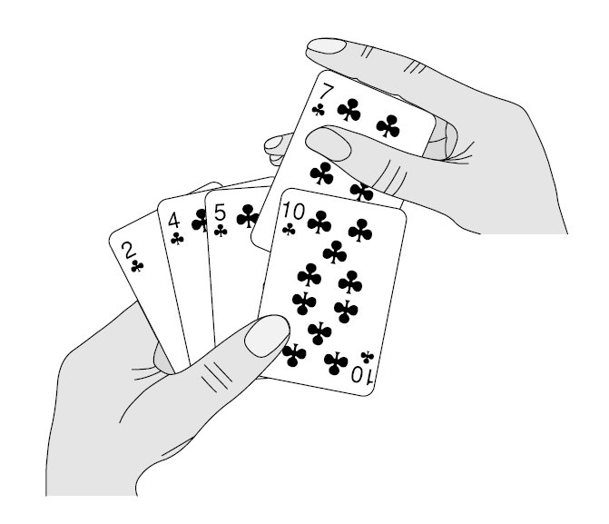
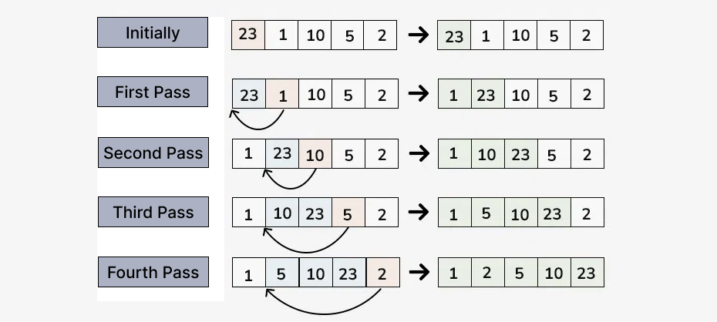
Insertion Sort

Slide 7
Insertion Sort

Slide 8
Insertion Sort: Pseudocode
INSERTION-SORT (A)
for j = 2 to A.length
key = A[j]
// Insert A[j] into the sorted sequence A[1 .. j-1].
i = j - 1
while i > 0 and A[i] > key
A[i+1] = A[i]
i = i - 1
A[i+1] = key
Loop invariant: A[1 .. j-1] are the elements originally in positions 1 through j-1, but now in sorted order.
Notes:
A[1 .. j-1] are the elements originally in positions 1 through j-1, but now in sorted order. Loop invariant
Initialization: The loop invariant is true prior to the first iteration of the loop.
Maintenance: If it is true before an iteration of the loop, it remains true before the next iteration.
Termination: When the loop terminates, the invariant gives us a useful property that helps show that the algorithm is correct.

Slide 9
Insertion Sort: Correctness: Proof
Initialization: The loop invariant is true prior to the first iteration of the loop.
Maintenance: If it is true before an iteration of the loop, it remains true before the next iteration.
Termination: When the loop terminates, the invariant gives us a useful property that helps show that the algorithm is correct.

Slide 10
Analyzing Algorithms
Analyzing an algorithm has come to mean predicting the resources that the algorithm requires.
time
memory
communication bandwidth
hardware
…
A model of the implementation technology that we will use is a generic one-processor, random-access machine (RAM) model of computation.
Notes:
RAM has primitive instustions only. No magic instructions. X^y is not constant in generic case, 2^k is constant.
No caches, no virtual memory

Slide 11
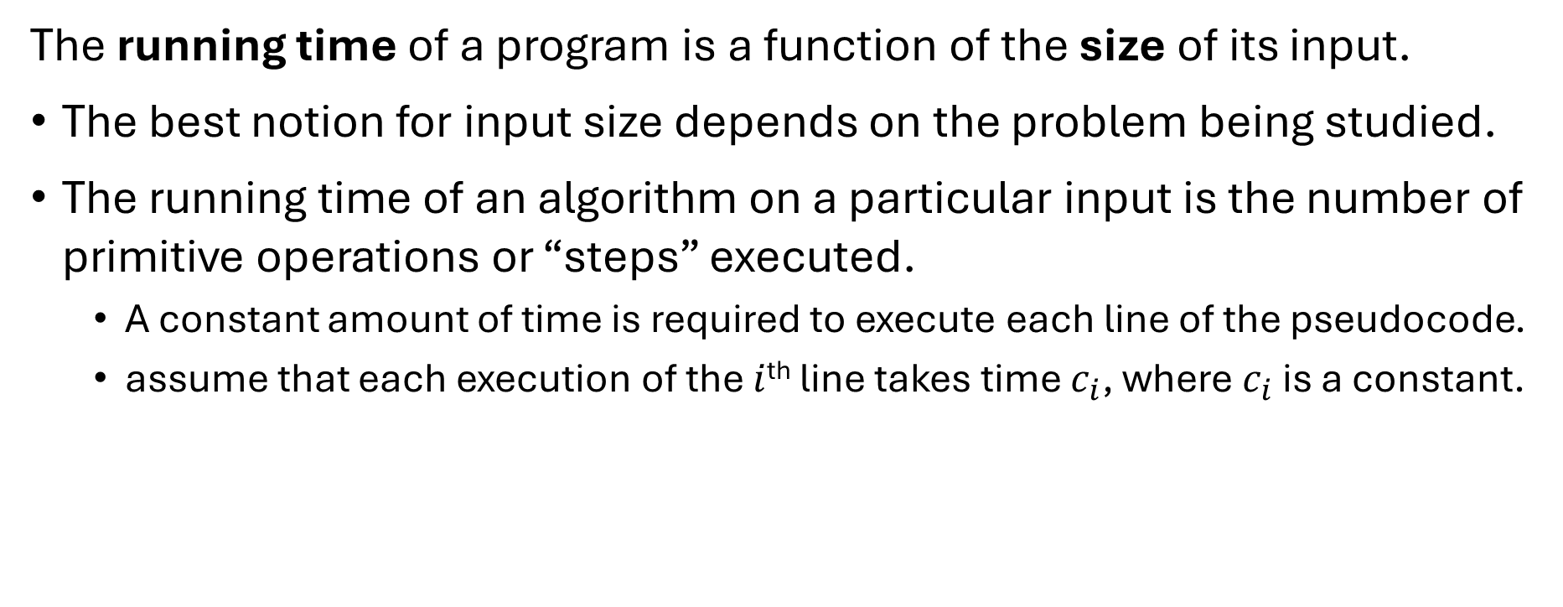
Insertion Sort: Analyzing (1)
The running time of a program is a function of the size of its input.
The best notion for input size depends on the problem being studied.
The running time of an algorithm on a particular input is the number of primitive operations or “steps” executed.
A constant amount of time is required to execute each line of the pseudocode.
assume that each execution of the $i$^{th} line takes time $c_{i}$, where $c_{i}$ is a constant.
Notes:
Input size depends on a problem.

Slide 12
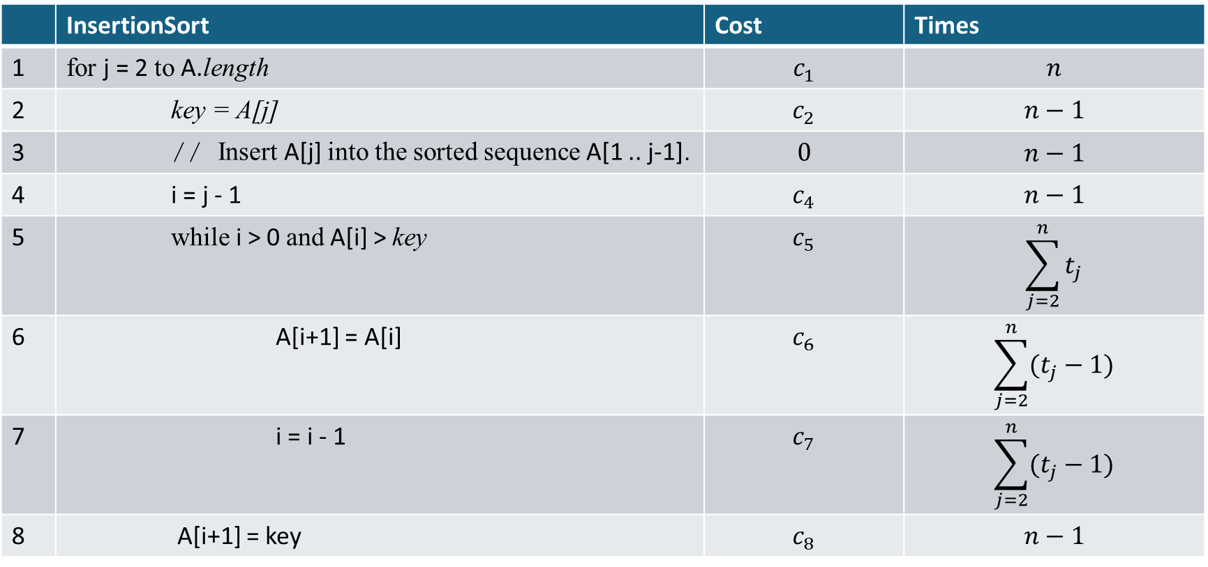
Insertion Sort: Analyzing (2)
 | InsertionSort | Cost | Times
1 | for j = 2 to A.length | $$c_{1}$$ | $$n$$
2 | key = A[j] | $$c_{2}$$ | $$n−1$$
3 | // Insert A[j] into the sorted sequence A[1 .. j-1]. | $$0$$ | $$n−1$$
4 | i = j - 1 | $$c_{4}$$ | $$n−1$$
5 | while i > 0 and A[i] > key | $$c_{5}$$ | $$\sum_{j=2}^{n}{t_{j}}$$
6 | A[i+1] = A[i] | $$c_{6}$$ | $$\sum_{j=2}^{n}{(t_{j}−1)}$$
7 | i = i - 1 | $$c_{7}$$ | $$\sum_{j=2}^{n}{(t_{j}−1)}$$
8 | A[i+1] = key | $$c_{8}$$ | $$n−1$$

Slide 13
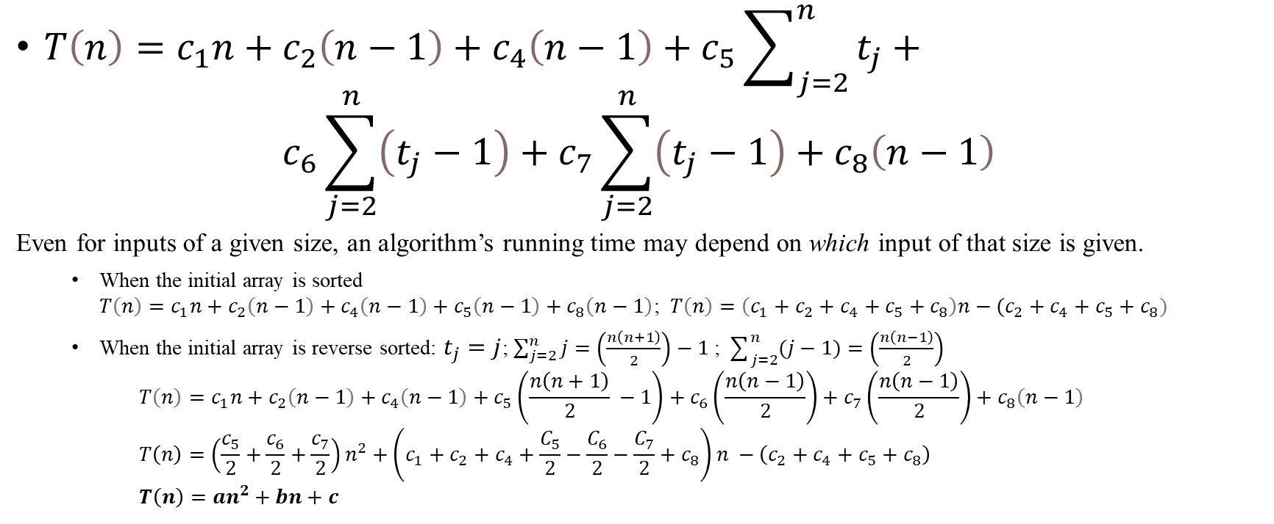
Insertion Sort: Analyzing (3)
$T\left(n\right)=c_{1}n+c_{2}\left(n−1\right)+c_{4}\left(n−1\right)+c_{5}\sum_{j=2}^{n}{t_{j}}+$ $c_{6}\sum_{j=2}^{n}{\left(t_{j}−1\right)}+c_{7}\sum_{j=2}^{n}{\left(t_{j}−1\right)}+c_{8}\left(n−1\right)$
Even for inputs of a given size, an algorithm’s running time may depend on which input of that size is given.
When the initial array is sorted $T\left(n\right)=c_{1}n+c_{2}\left(n−1\right)+c_{4}\left(n−1\right)+c_{5}\left(n−1\right)+c_{8}\left(n−1\right)$; $T\left(n\right)=\left(c_{1}+c_{2}+c_{4}+c_{5}+c_{8}\right)n−(c_{2}+c_{4}+c_{5}+c_{8})$
When the initial array is reverse sorted: $t_{j}=j$; $\sum_{j=2}^{n}{j}=\left(\frac{n\left(n+1\right)}{2}\right)−1$ ; $\sum_{j=2}^{n}{(j−1)}=\left(\frac{n\left(n−1\right)}{2}\right)$ $T\left(n\right)=c_{1}n+c_{2}\left(n−1\right)+c_{4}\left(n−1\right)+c_{5}\left(\frac{n\left(n+1\right)}{2} −1\right)+c_{6}\left(\frac{n\left(n−1\right)}{2}\right)+c_{7}\left(\frac{n\left(n−1\right)}{2}\right)+c_{8}\left(n−1\right)$ $T\left(n\right)=\left(\frac{c_{5}}{2}+\frac{c_{6}}{2}+\frac{c_{7}}{2}\right)n^{2}+\left(c_{1}+c_{2}+c_{4}+\frac{C_{5}}{2}−\frac{C_{6}}{2}−\frac{C_{7}}{2}+c_{8}\right)n −\left(c_{2}+c_{4}+c_{5}+c_{8}\right)$ $T\left(n\right)=an^{2}+bn+c$
Notes:
Typically, as in insertion sort, the running time of an algorithm is fixed for a given input, although in later chapters we shall see some interesting “randomized” algorithms whose behavior can vary even for a fixed input.

Slide 14

Insertion Sort: Analyzing (3)
$$T\left(n\right)=c_{1}n+c_{2}\left(n−1\right)+c_{4}\left(n−1\right)+c_{5}\sum_{j=2}^{n}{t_{j}}+ \\ c_{6}\sum_{j=2}^{n}{\left(t_{j}−1\right)}+c_{7}\sum_{j=2}^{n}{\left(t_{j}−1\right)}+c_{8}\left(n−1\right)$$
Notes:
Typically, as in insertion sort, the running time of an algorithm is fixed for a given input, although in later chapters we shall see some interesting “randomized” algorithms whose behavior can vary even for a fixed input.

Slide 15
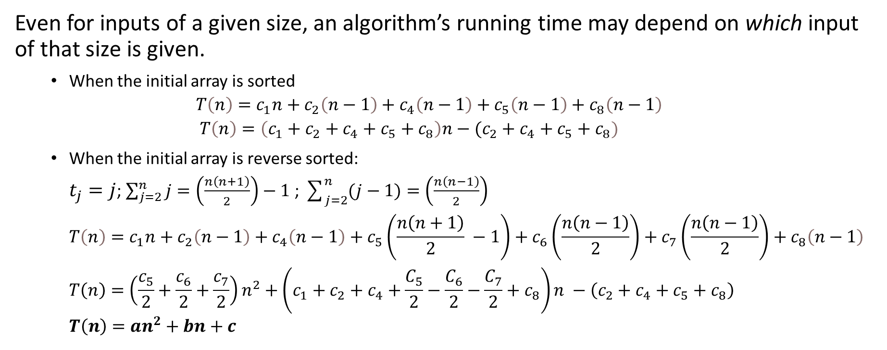
Insertion Sort: Analyzing (4)
Even for inputs of a given size, an algorithm’s running time may depend on which input of that size is given.
When the initial array is sorted $T\left(n\right)=c_{1}n+c_{2}\left(n−1\right)+c_{4}\left(n−1\right)+c_{5}\left(n−1\right)+c_{8}\left(n−1\right)$ $T\left(n\right)=\left(c_{1}+c_{2}+c_{4}+c_{5}+c_{8}\right)n−(c_{2}+c_{4}+c_{5}+c_{8})$
When the initial array is reverse sorted: $t_{j}=j$; $\sum_{j=2}^{n}{j}=\left(\frac{n\left(n+1\right)}{2}\right)−1$ ; $\sum_{j=2}^{n}{(j−1)}=\left(\frac{n\left(n−1\right)}{2}\right)$ $T\left(n\right)=c_{1}n+c_{2}\left(n−1\right)+c_{4}\left(n−1\right)+c_{5}\left(\frac{n\left(n+1\right)}{2} −1\right)+c_{6}\left(\frac{n\left(n−1\right)}{2}\right)+c_{7}\left(\frac{n\left(n−1\right)}{2}\right)+c_{8}\left(n−1\right)$ $T\left(n\right)=\left(\frac{c_{5}}{2}+\frac{c_{6}}{2}+\frac{c_{7}}{2}\right)n^{2}+\left(c_{1}+c_{2}+c_{4}+\frac{C_{5}}{2}−\frac{C_{6}}{2}−\frac{C_{7}}{2}+c_{8}\right)n −\left(c_{2}+c_{4}+c_{5}+c_{8}\right)$ $T\left(n\right)=an^{2}+bn+c$
Notes:
Typically, as in insertion sort, the running time of an algorithm is fixed for a given input, although in later chapters we shall see some interesting “randomized” algorithms whose behavior can vary even for a fixed input.

Slide 16
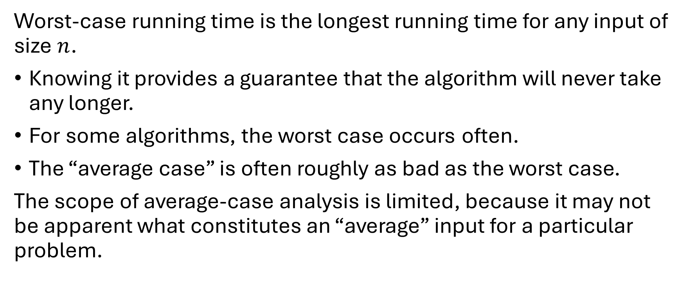
Worst-case and Average-case Analysis
Worst-case running time is the longest running time for any input of size $n$.
Knowing it provides a guarantee that the algorithm will never take any longer.
For some algorithms, the worst case occurs often.
The “average case” is often roughly as bad as the worst case.
The scope of average-case analysis is limited, because it may not be apparent what constitutes an “average” input for a particular problem.

Slide 17
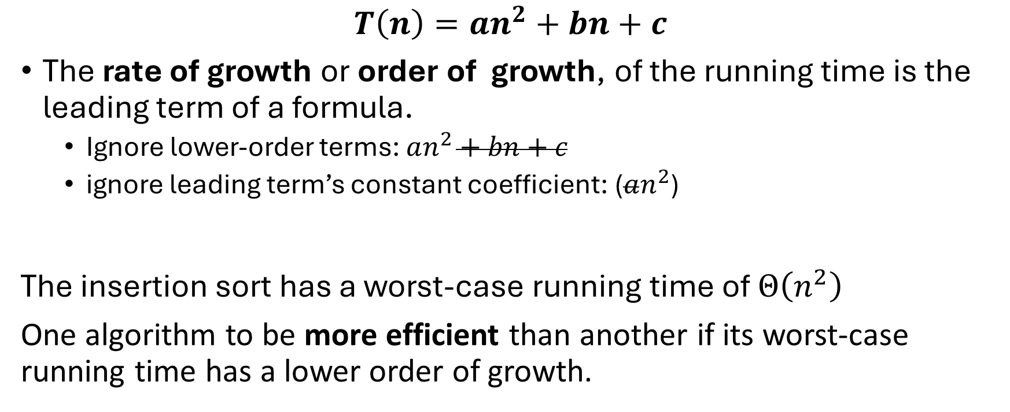
Order of Growth
$$T\left(n\right)=an^{2}+bn+c$$
The rate of growth or order of growth, of the running time is the leading term of a formula.
Ignore lower-order terms: $an^{2}+bn+c$
ignore leading term’s constant coefficient: ($an^{2}$)
The insertion sort has a worst-case running time of $Θ\left(n^{2}\right)$
One algorithm to be more efficient than another if its worst-case running time has a lower order of growth.

Slide 18
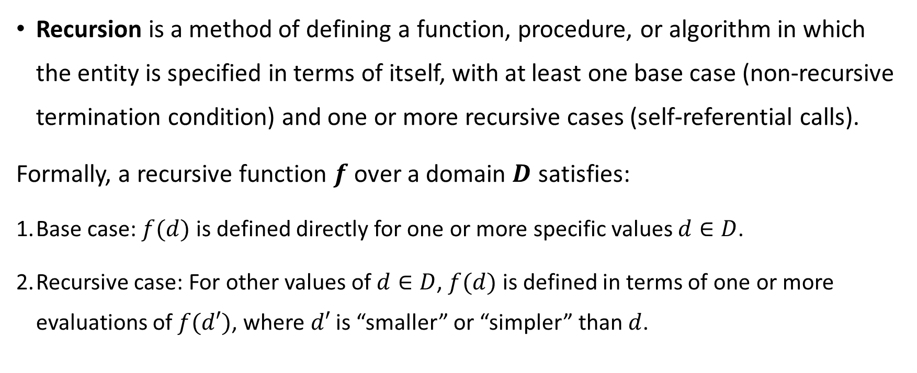
Recursion
Recursion is a method of defining a function, procedure, or algorithm in which the entity is specified in terms of itself, with at least one base case (non-recursive termination condition) and one or more recursive cases (self-referential calls).
Formally, a recursive function $f$ over a domain $D$ satisfies:
Base case: $f(d)$ is defined directly for one or more specific values $d∈D$.
Recursive case: For other values of $d∈D$, $f(d)$ is defined in terms of one or more evaluations of $f(d′)$, where $d′$ is “smaller” or “simpler” than $d$.

Slide 19
The Divide-and-conquer Approach
Many useful algorithms are recursive in structure. These algorithms typically follow a divide-and-conquer approach:
Divide the problem into several subproblems that are similar to the original problem but smaller in size
Conquer the subproblems recursively.*
Combine solutions to create a solution to the original problem.
Notes:
If the subproblem sizes are small enough, however, just solve the subproblems in a straightforward manner

Slide 20
Merge Sort
The merge sort algorithm closely follows the divide-and-conquer paradigm.
Divide: Divide the n-element sequence to be sorted into two subsequences of n/2 elements each.
Conquer: Sort the two subsequences recursively using merge sort.
Combine: Merge the two sorted subsequences to produce the sorted answer.
The recursion “bottoms out” when the sequence to be sorted has length 1

Slide 21
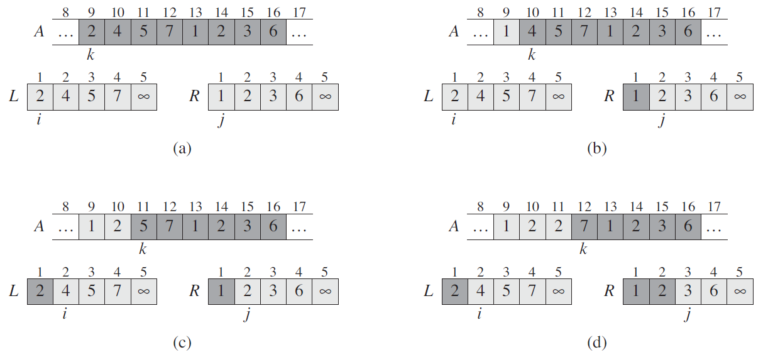
Merge Sort: Merge(A, p, q, r)

Slide 22
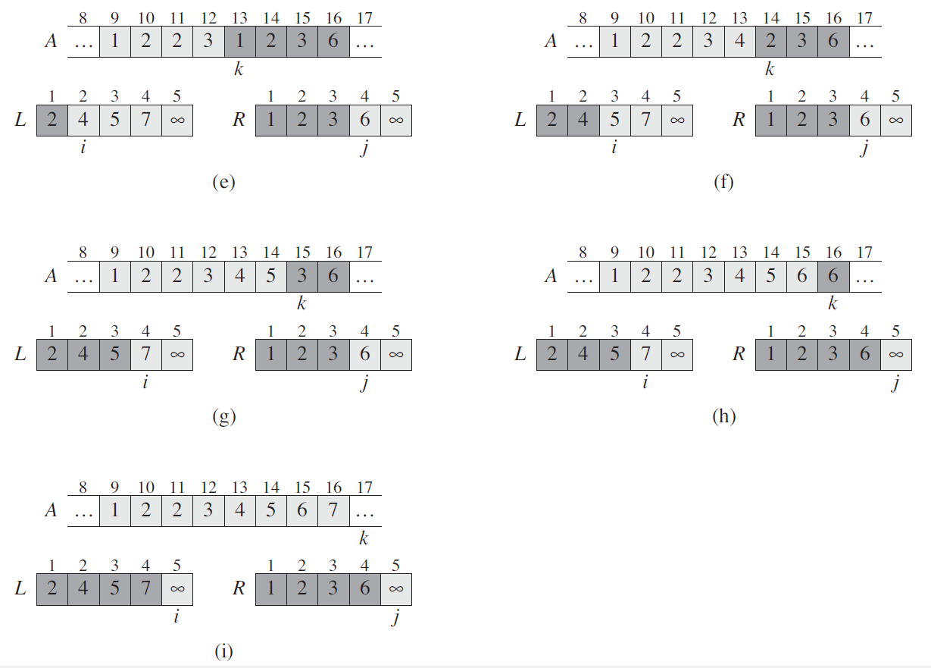
Merge Sort: Merge(A, p, q, r)

Slide 23
Merge Sort: Merge

Slide 24
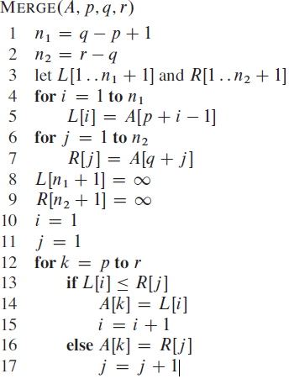
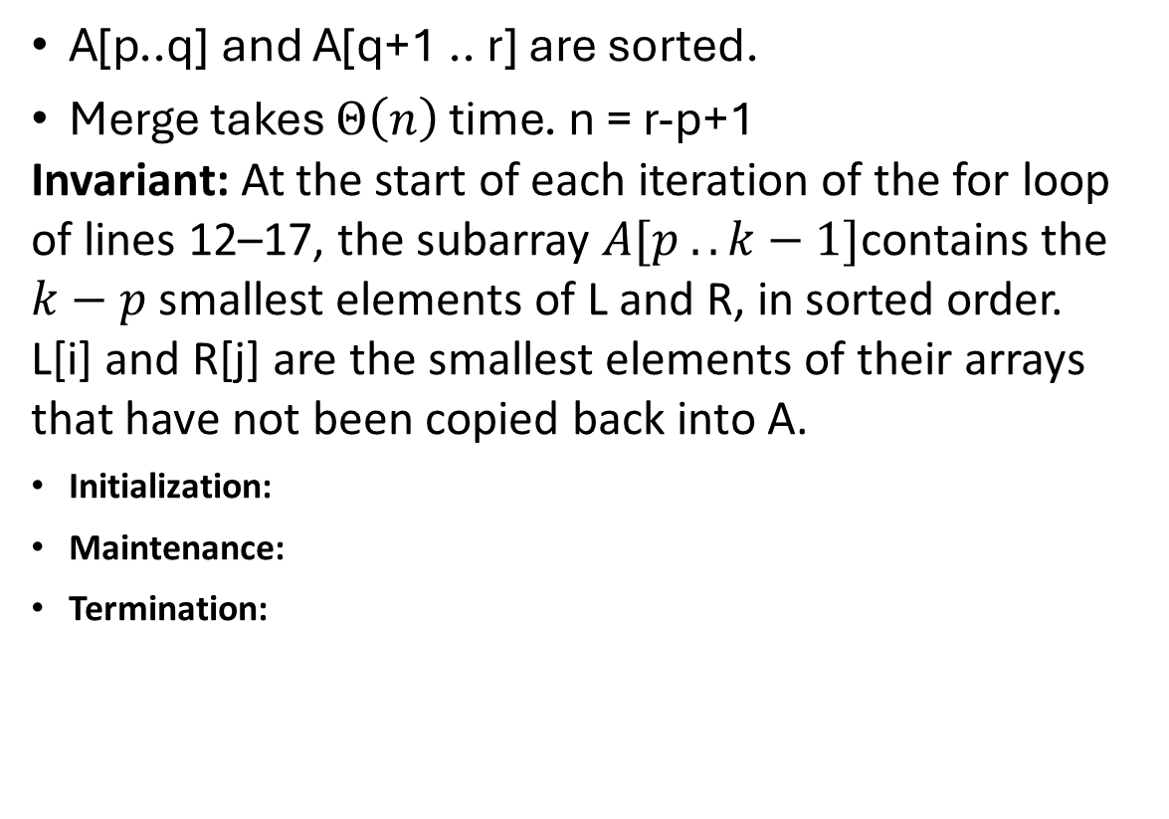
Merge Sort: Merge(A, p, q, r)
A[p..q] and A[q+1 .. r] are sorted.
Merge takes $Θ\left(n\right)$ time. n = r-p+1
Invariant: At the start of each iteration of the for loop of lines 12–17, the subarray $A[p .. k−1]$contains the $k−p$ smallest elements of L and R, in sorted order.
L[i] and R[j] are the smallest elements of their arrays that have not been copied back into A.
Initialization:
Maintenance:
Termination:

Slide 25
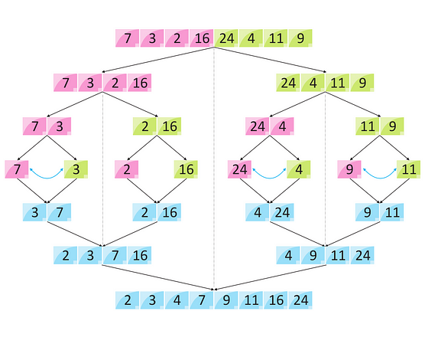
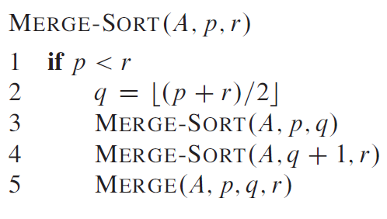
Merge Sort

Slide 26
Merge Sort

Slide 27
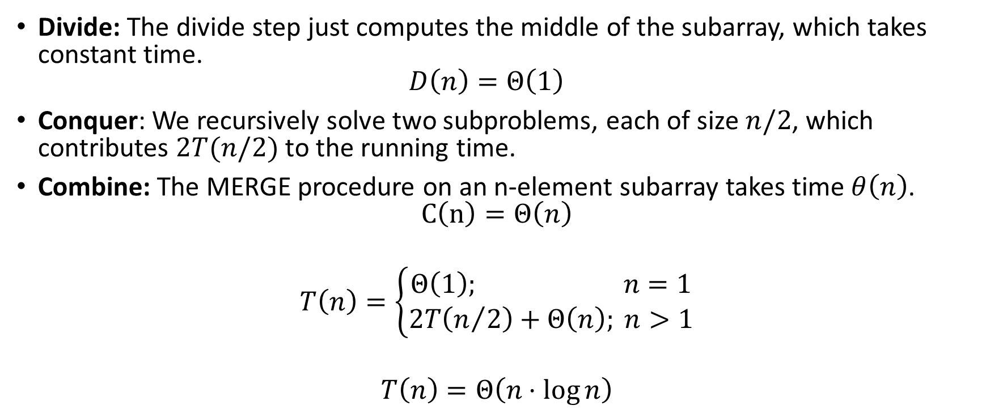
Analyzing Merge Sort (1)
Divide: The divide step just computes the middle of the subarray, which takes constant time. $D\left(n\right)=Θ\left(1\right)$
Conquer: We recursively solve two subproblems, each of size $n/2$, which contributes $2T(n/2)$ to the running time.
Combine: The MERGE procedure on an n-element subarray takes time $θ\left(n\right)$. $C\left(n\right)=Θ\left(n\right)$
$$T\left(n\right)=\left\{\begin{matrix}Θ\left(1\right); n=1 \\ 2T\left(n/2\right)+Θ\left(n\right); n>1\end{matrix}\right.$$
$$T\left(n\right)=Θ\left(n⋅\log{n}\right)$$

Slide 28
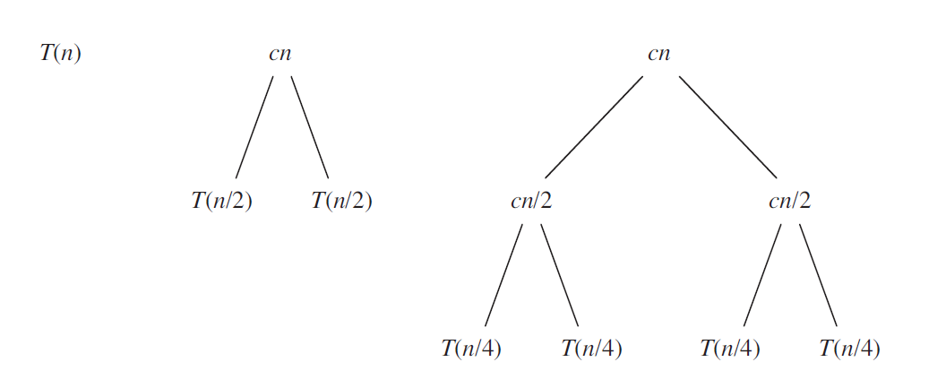

Analyzing Merge Sort (2)
$$T\left(n\right)=\left\{\begin{matrix}cn; n=1 \\ 2T\left(n/2\right)+cn; n>1\end{matrix}\right.$$

Slide 29
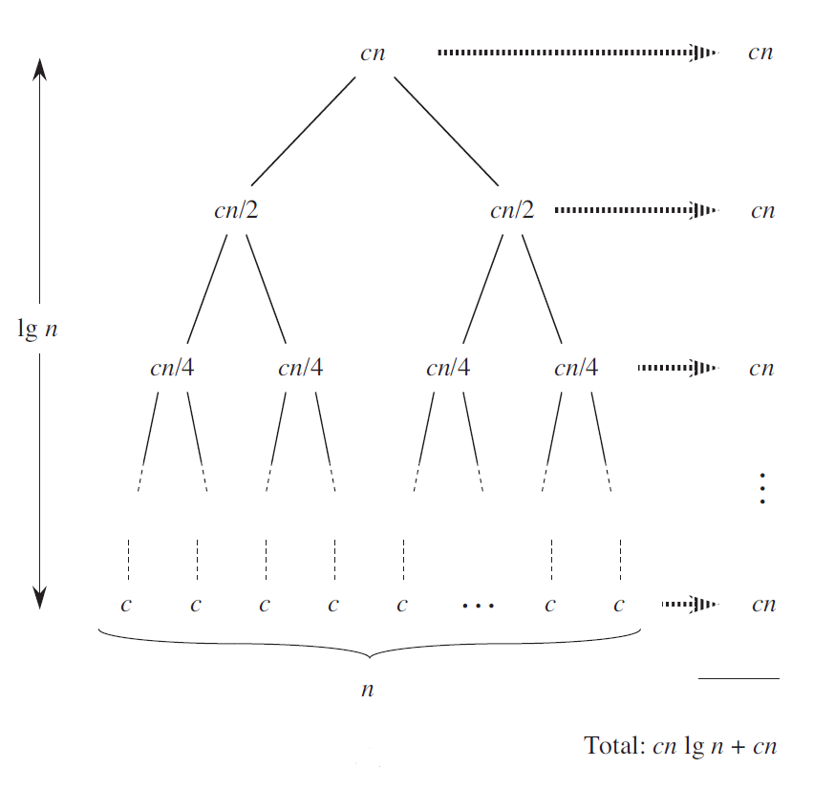
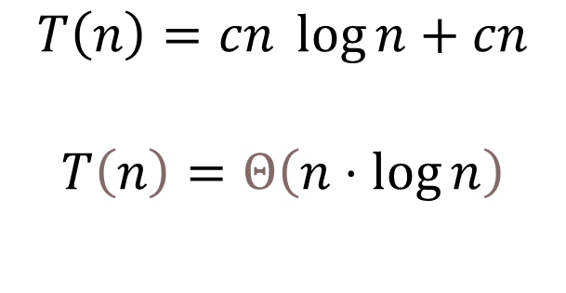
Analyzing Merge Sort (3)
$$T\left(n\right)=cn \log{n}+cn$$
$$T\left(n\right)=Θ\left(n⋅\log{n}\right)$$

Slide 30
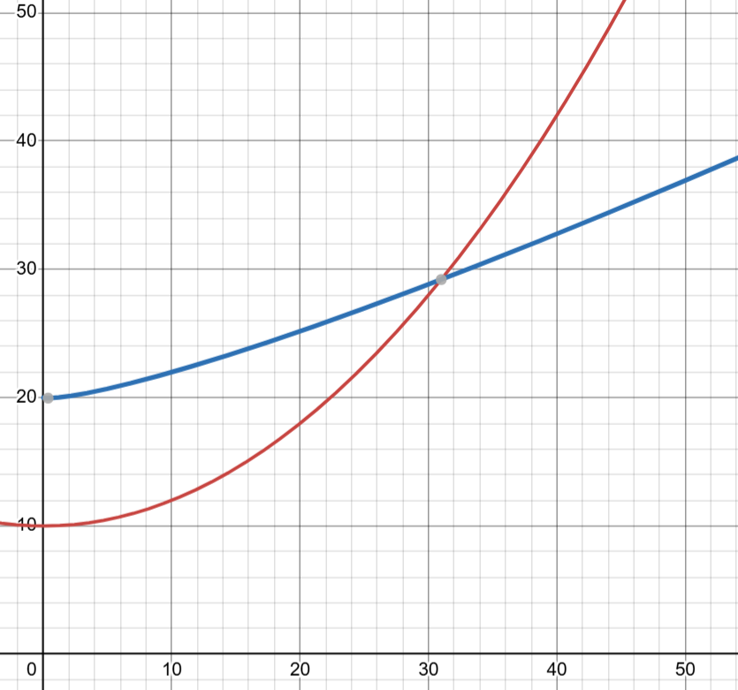

The Growth of The Running Time
Worst-case:
Merge Sort - $Θ\left(n⋅\log{n}\right)$
Insertion Sort - $Θ\left(n^{2}\right)$
Notes:
Reminder: The growth of the running time of an algorithm refers to how the execution time of an algorithm increases as the size of its input grows.

Slide 31
Asymptotic Efficiency
The growth of the running time of an algorithm refers to how the execution time of an algorithm increases as the size of its input grows.
Growth order
The asymptotic efficiency of an algorithm refers to its performance in terms of time complexity and space complexity as the input size (𝑛) becomes very large.
Asymptotic efficiency
Notes:
Asymptotic Efficiency focuses on analyzing the growth rate of the algorithm's resource usage (e.g., running time or memory) while ignoring constant factors and lower-order terms.
Usually, an algorithm that is asymptotically more efficient will be the best choice
for all but very small inputs.

Slide 32
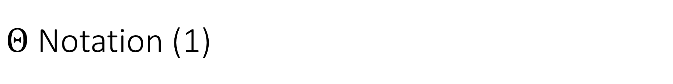
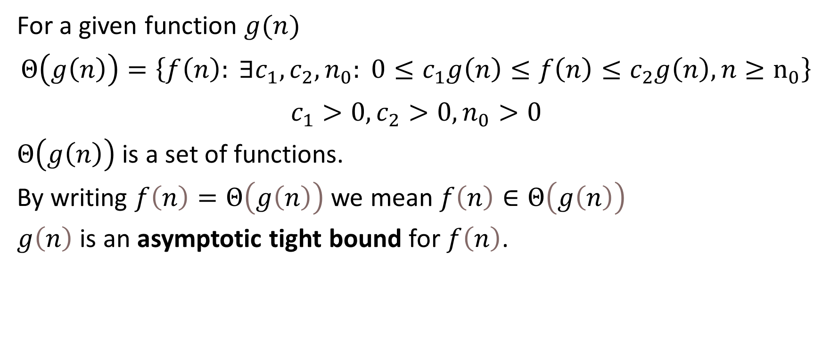
$Θ$ Notation (1)
For a given function $g(n)$
$$Θ\left(g\left(n\right)\right)=\left\{f\left(n\right): ∃c_{1},c_{2},n_{0}: 0≤c_{1}g\left(n\right)≤f\left(n\right)≤c_{2}g\left(n\right),n≥n_{0}\right\}$$
$$c_{1}>0,c_{2}>0,n_{0}>0$$
$Θ\left(g\left(n\right)\right)$ is a set of functions.
By writing $f\left(n\right)=Θ\left(g\left(n\right)\right)$ we mean $f\left(n\right)∈Θ\left(g\left(n\right)\right)$
$g\left(n\right)$ is an asymptotic tight bound for $f\left(n\right)$.
Notes:
For all $n≥n_{0}$, the function $f\left(n\right)$ is equal to $g\left(n\right)$ to withing constant factor.
The definition of $Θ\left(g\left(n\right)\right)$ requires that every member f $f\left(n\right)$ be asymptotically nonnegative, that is, that $f\left(n\right)$ be nonnegative whenever n is sufficiently large. (An asymptotically positive function is one that is positive for all sufficiently large n.)
Consequently, the function $g\left(n\right)$ itself must be asymptotically nonnegative, or else the set $g\left(n\right)$ is empty.

Slide 33
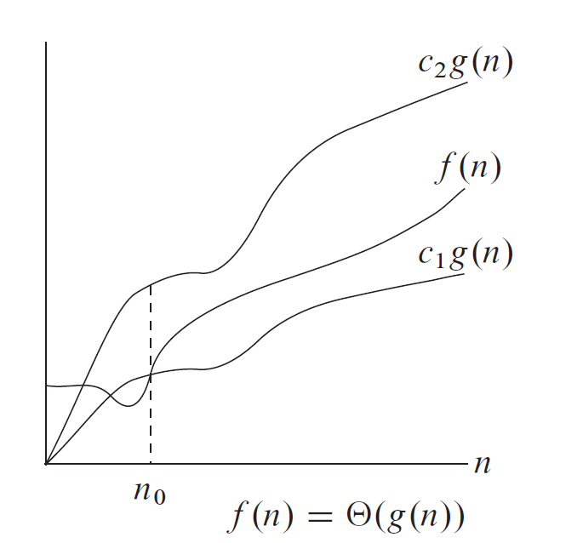
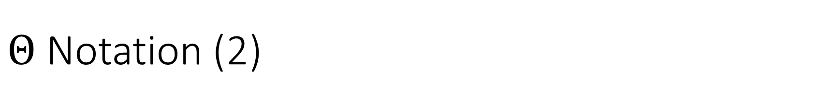
$Θ$ Notation (2)

Slide 34
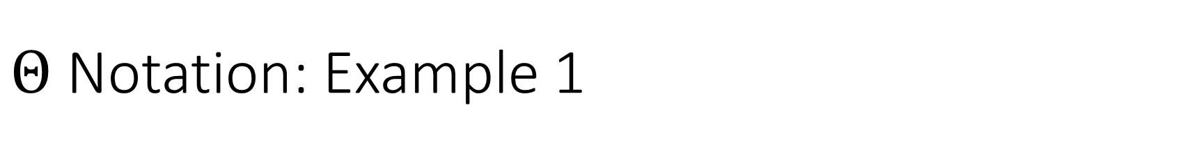

$Θ$ Notation: Example 1
Let: $f\left(n\right)=3n^{2}−2n$
Show: $f\left(n\right)=Θ\left(n^{2}\right)$
$$c_{1}n^{2}≤3n^{2}−2n≤c_{2}n^{2};c_{1}>0,c_{2}>0,n_{0}>0$$
$$c_{1}≤3−\frac{2}{n}≤c_{2}$$
$$n_{0}=1; c_{1}=\frac{1}{2}; c_{2}=4$$
$$\frac{1}{2}n^{2}≤3n^{2}−2n≤4n^{2}; n≥1$$
Notes:
show $n^{3}$ != $Θ\left(n^{2}\right)$

Slide 35
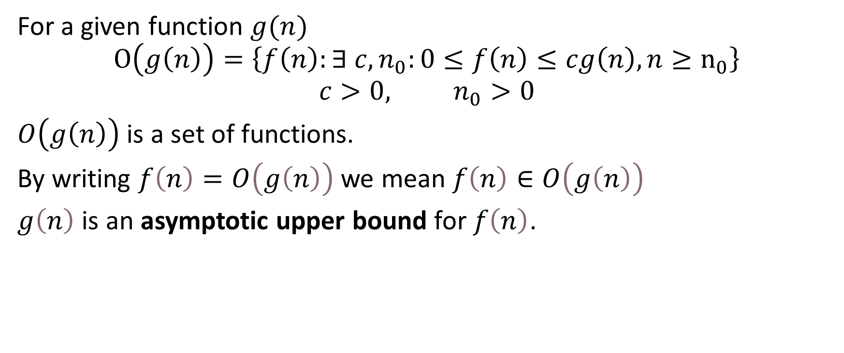
O notation (1)
For a given function $g(n)$
$$O\left(g\left(n\right)\right)=\left\{f\left(n\right):∃ c,n_{0}:0≤f\left(n\right)≤cg\left(n\right),n≥n_{0}\right\}$$
$$c>0, n_{0}>0$$
$O\left(g\left(n\right)\right)$ is a set of functions.
By writing $f\left(n\right)=O\left(g\left(n\right)\right)$ we mean $f\left(n\right)∈O\left(g\left(n\right)\right)$
$g\left(n\right)$ is an asymptotic upper bound for $f\left(n\right)$.

Slide 36
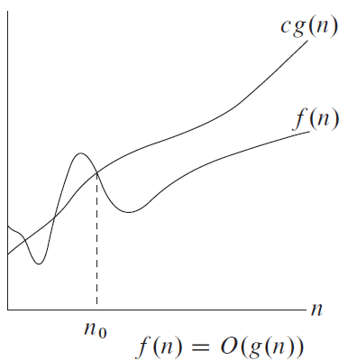
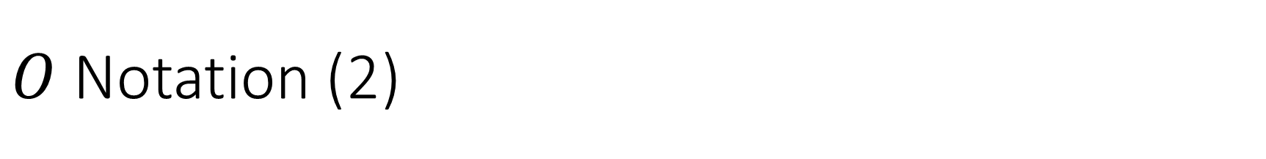
$O$ Notation (2)

Slide 37
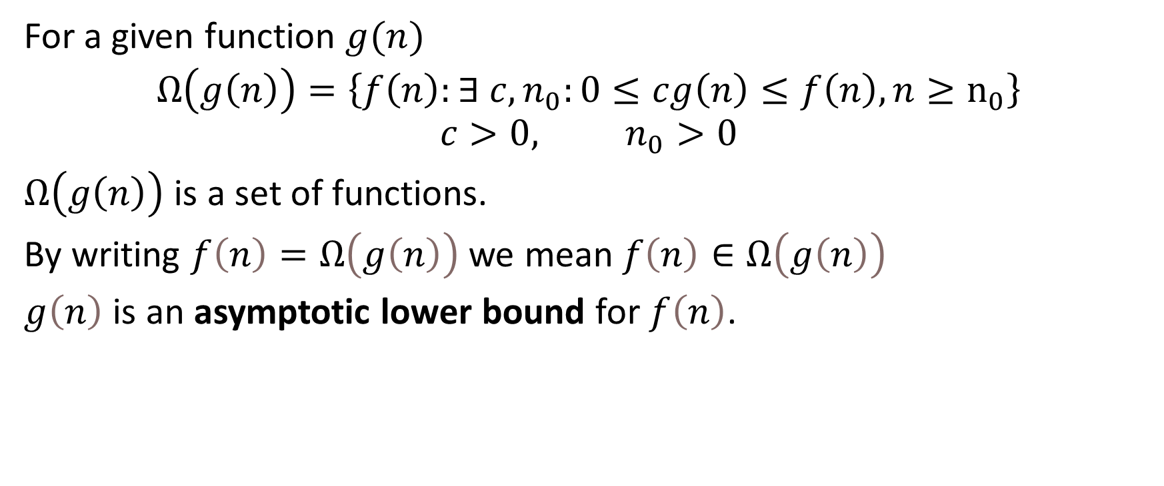
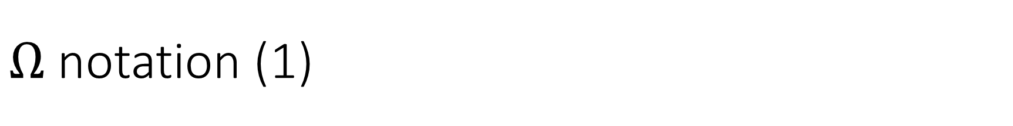
$Ω$ notation (1)
For a given function $g(n)$
$$Ω\left(g\left(n\right)\right)=\left\{f\left(n\right):∃ c,n_{0}:0≤cg\left(n\right)≤f\left(n\right),n≥n_{0}\right\}$$
$$c>0, n_{0}>0$$
$Ω\left(g\left(n\right)\right)$ is a set of functions.
By writing $f\left(n\right)=Ω\left(g\left(n\right)\right)$ we mean $f\left(n\right)∈Ω\left(g\left(n\right)\right)$
$g\left(n\right)$ is an asymptotic lower bound for $f\left(n\right)$.

Slide 38
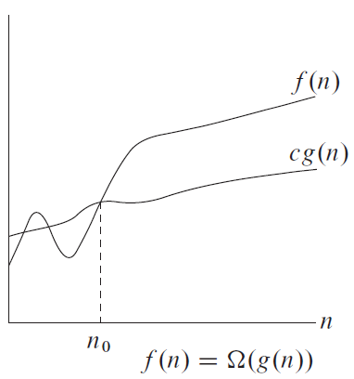
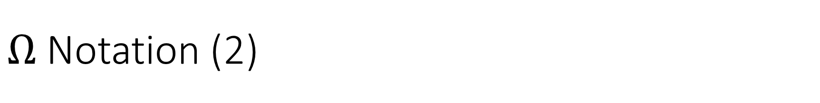
$Ω$ Notation (2)

Slide 39

Theorem
For any two functions $f\left(n\right)$ and $g\left(n\right)$, we have
$$f\left(n\right)=Θ\left(g\left(n\right)\right)$$ if and only if $$f\left(n\right)=O\left(g\left(n\right)\right)$$ and
$$f\left(n\right)=Ω\left(g\left(n\right)\right)$$

Slide 40
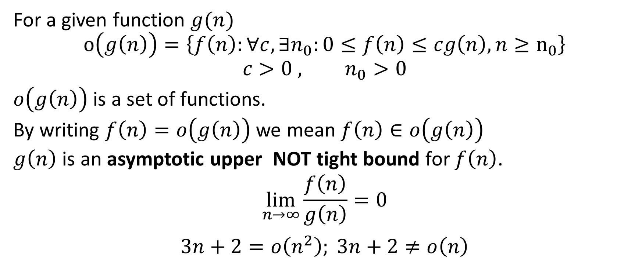
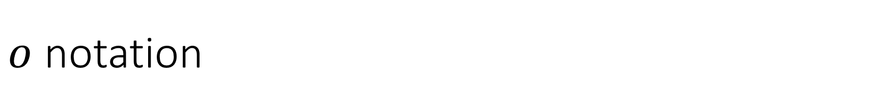
$o$ notation
For a given function $g(n)$
$$o\left(g\left(n\right)\right)=\left\{f\left(n\right):\text{∀}c,∃n_{0}:0≤f\left(n\right)≤cg\left(n\right),n≥n_{0}\right\}$$
$$c>0 , n_{0}>0$$
$o\left(g\left(n\right)\right)$ is a set of functions.
By writing $f\left(n\right)=o\left(g\left(n\right)\right)$ we mean $f\left(n\right)∈o\left(g\left(n\right)\right)$
$g\left(n\right)$ is an asymptotic upper NOT tight bound for $f\left(n\right)$.
$$\lim_{n→∞}\frac{f\left(n\right)}{g\left(n\right)}=0$$
$$3n+2=o\left(n^{2}\right); 3n+2≠o\left(n\right)$$

Slide 41
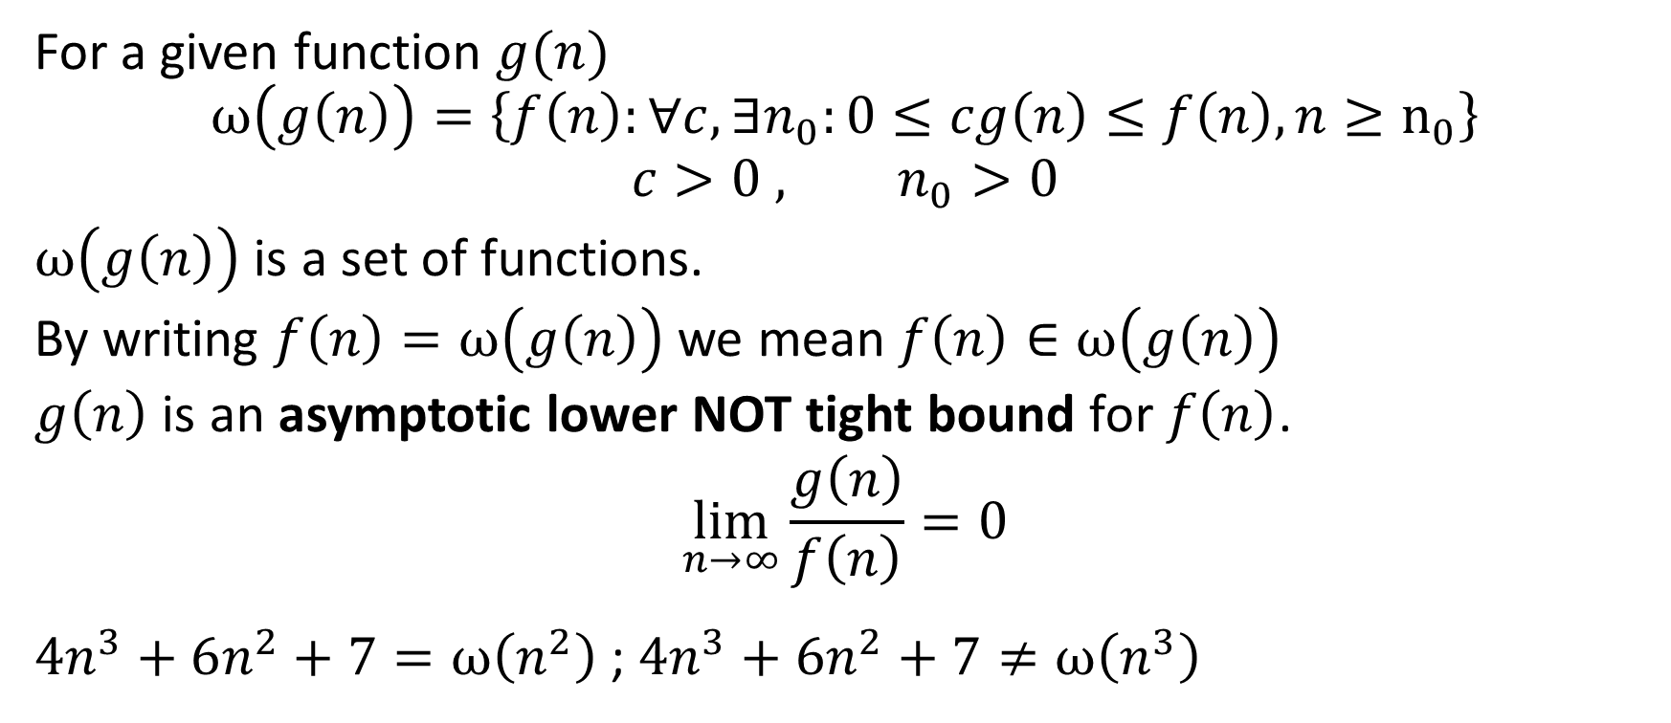
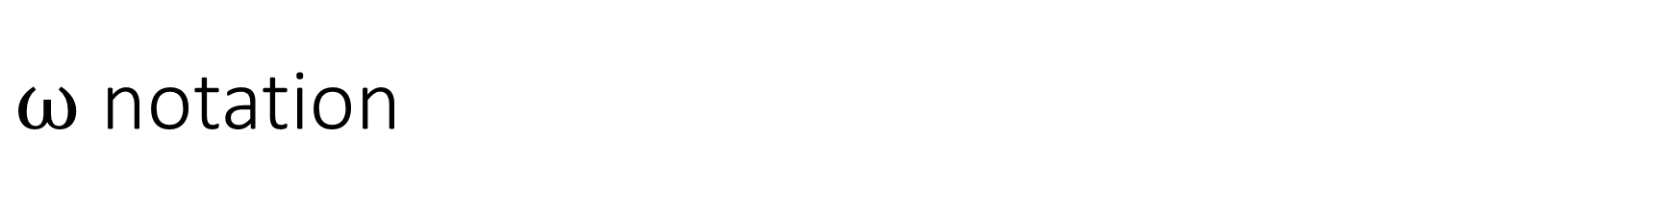
$ω$ notation
For a given function $g(n)$
$$ω\left(g\left(n\right)\right)=\left\{f\left(n\right):\text{∀}c,∃n_{0}:0≤cg\left(n\right)≤f\left(n\right),n≥n_{0}\right\}$$
$$c>0 , n_{0}>0$$
$ω\left(g\left(n\right)\right)$ is a set of functions.
By writing $f\left(n\right)=ω\left(g\left(n\right)\right)$ we mean $f\left(n\right)∈ω\left(g\left(n\right)\right)$
$g\left(n\right)$ is an asymptotic lower NOT tight bound for $f\left(n\right)$.
$$\lim_{n→∞}\frac{g\left(n\right)}{f\left(n\right)}=0$$
$4n^{3}+6n^{2}+7=ω\left(n^{2}\right)$ ; $4n^{3}+6n^{2}+7≠ω\left(n^{3}\right)$

Slide 42
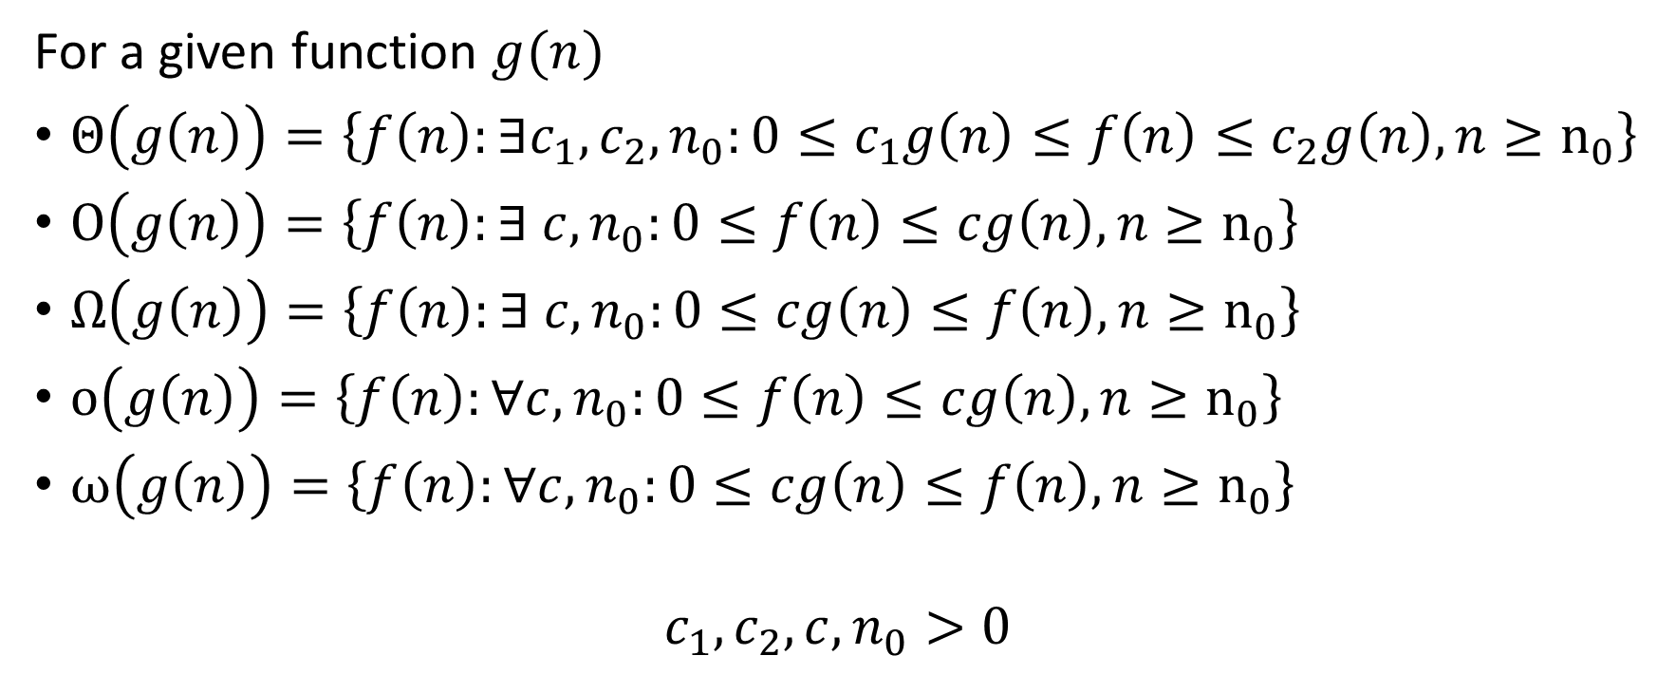
Asymptotic Notations
For a given function $g(n)$
$Θ\left(g\left(n\right)\right)=\left\{f\left(n\right):∃c_{1},c_{2},n_{0}:0≤c_{1}g\left(n\right)≤f\left(n\right)≤c_{2}g\left(n\right),n≥n_{0}\right\}$
$O\left(g\left(n\right)\right)=\left\{f\left(n\right):∃ c,n_{0}:0≤f\left(n\right)≤cg\left(n\right),n≥n_{0}\right\}$
$Ω\left(g\left(n\right)\right)=\left\{f\left(n\right):∃ c,n_{0}:0≤cg\left(n\right)≤f\left(n\right),n≥n_{0}\right\}$
$o\left(g\left(n\right)\right)=\left\{f\left(n\right):\text{∀}c,n_{0}:0≤f\left(n\right)≤cg\left(n\right),n≥n_{0}\right\}$
$ω\left(g\left(n\right)\right)=\left\{f\left(n\right):\text{∀}c,n_{0}:0≤cg\left(n\right)≤f\left(n\right),n≥n_{0}\right\}$
$$c_{1},c_{2},c,n_{0}>0$$

Slide 43
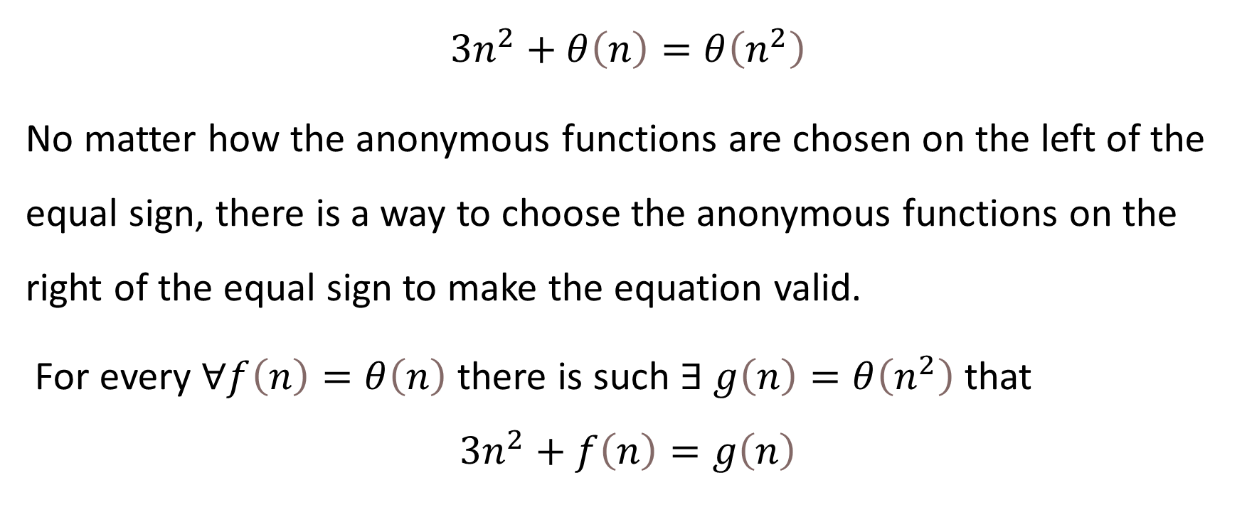
Asymptotic Notation in Equations
$$3n^{2}+θ\left(n\right)=θ\left(n^{2}\right)$$
No matter how the anonymous functions are chosen on the left of the equal sign, there is a way to choose the anonymous functions on the right of the equal sign to make the equation valid.
For every $\text{∀}f\left(n\right)=θ\left(n\right)$ there is such $∃ g\left(n\right)=θ\left(n^{2}\right)$ that
$$3n^{2}+f\left(n\right)=g\left(n\right)$$

Slide 44
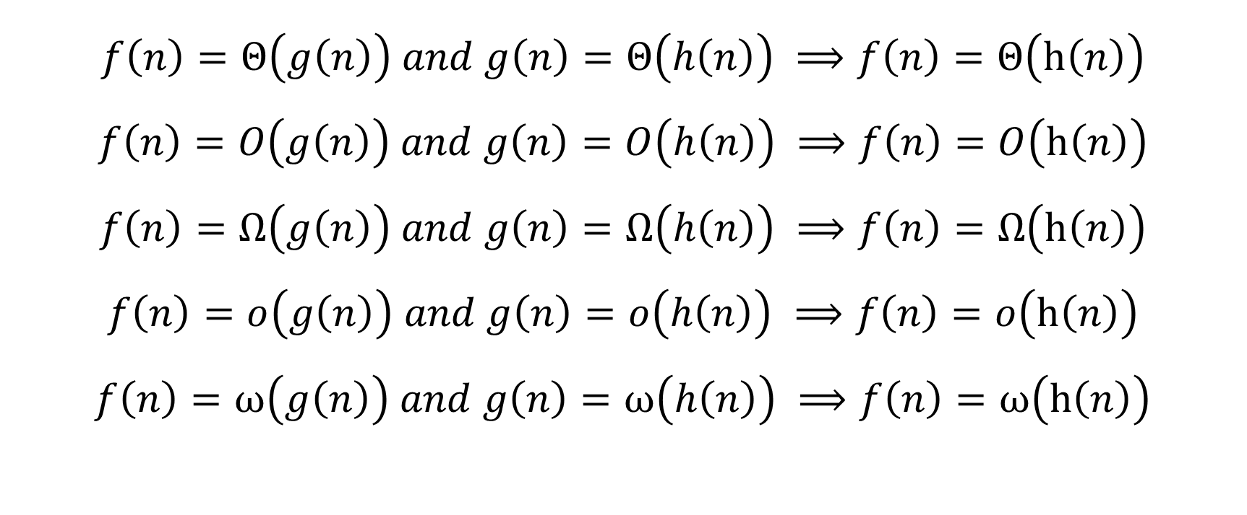
Transitivity of Asymptotic Notations
$$f\left(n\right)=Θ\left(g\left(n\right)\right) and g\left(n\right)=Θ\left(h\left(n\right)\right) ⟹f\left(n\right)=Θ\left(h\left(n\right)\right)$$
$$f\left(n\right)=O\left(g\left(n\right)\right) and g\left(n\right)=O\left(h\left(n\right)\right) ⟹f\left(n\right)=O\left(h\left(n\right)\right)$$
$$f\left(n\right)=Ω\left(g\left(n\right)\right) and g\left(n\right)=Ω\left(h\left(n\right)\right) ⟹f\left(n\right)=Ω\left(h\left(n\right)\right)$$
$$f\left(n\right)=o\left(g\left(n\right)\right) and g\left(n\right)=o\left(h\left(n\right)\right) ⟹f\left(n\right)=o\left(h\left(n\right)\right)$$
$$f\left(n\right)=ω\left(g\left(n\right)\right) and g\left(n\right)=ω\left(h\left(n\right)\right) ⟹f\left(n\right)=ω\left(h\left(n\right)\right)$$

Slide 45

Reflexivity of Asymptotic Notations
$$f\left(n\right)=Θ\left(f\left(n\right)\right)$$
$$f\left(n\right)=O\left(f\left(n\right)\right)$$
$$f\left(n\right)=Ω\left(f\left(n\right)\right)$$

Slide 46
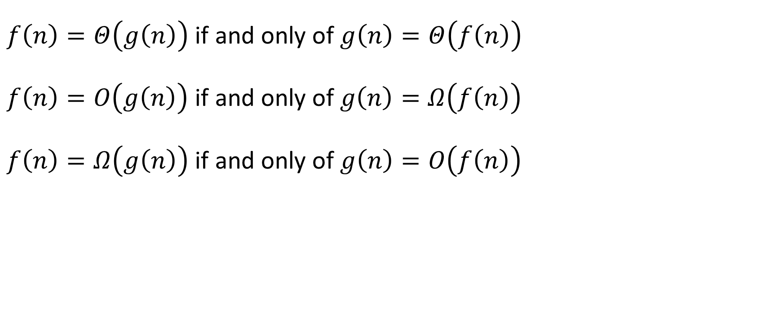
Symmetry of Asymptotic Notations
$f\left(n\right)=Θ\left(g\left(n\right)\right)$ if and only of $g\left(n\right)=Θ\left(f\left(n\right)\right)$
$f\left(n\right)=O\left(g\left(n\right)\right)$ if and only of $g\left(n\right)=Ω\left(f\left(n\right)\right)$
$f\left(n\right)=Ω\left(g\left(n\right)\right)$ if and only of $g\left(n\right)=O\left(f\left(n\right)\right)$

Slide 47
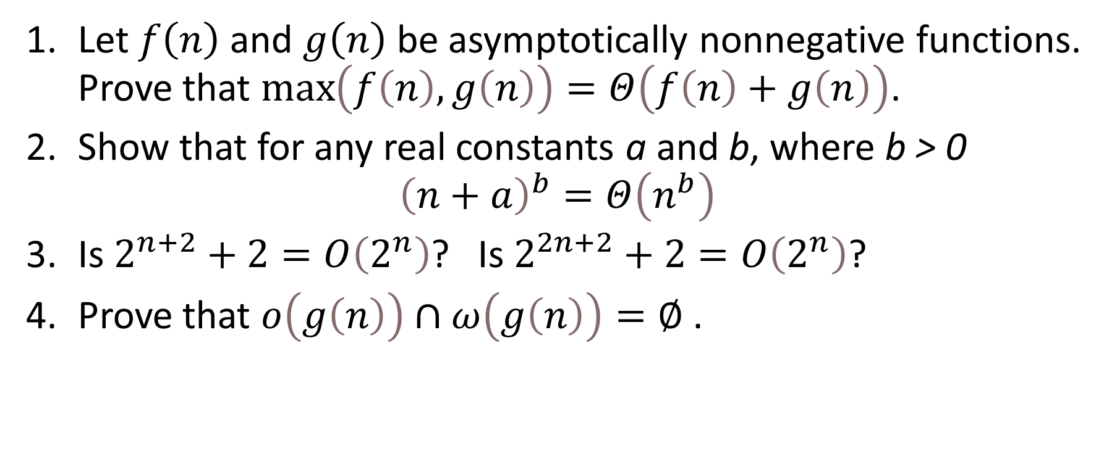
Exercises
Let $f\left(n\right)$ and $g\left(n\right)$ be asymptotically nonnegative functions. Prove that $\max\left(f\left(n\right),g\left(n\right)\right)=Θ\left(f\left(n\right)+g\left(n\right)\right)$.
Show that for any real constants a and b, where b > 0 ${\left(n+a\right)}^{b}=Θ\left(n^{b}\right)$
Is $2^{n+2}+2=O\left(2^{n}\right)$? Is $2^{2n+2}+2=O\left(2^{n}\right)$?
Prove that $o\left(g\left(n\right)\right)∩ω\left(g\left(n\right)\right)=∅$ .

Slide 48
Thank You

